Slide 1


GIT RESET
Presented By : Gaurav Sharma

Slide 2

www.knoldus.com
Git Reset Command
Git reset is a powerful command that is used to undo local changes to the state of a Git repo.

Slide 3
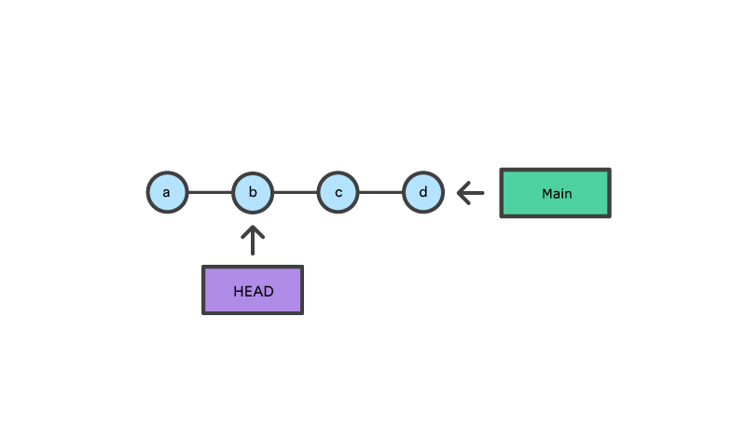
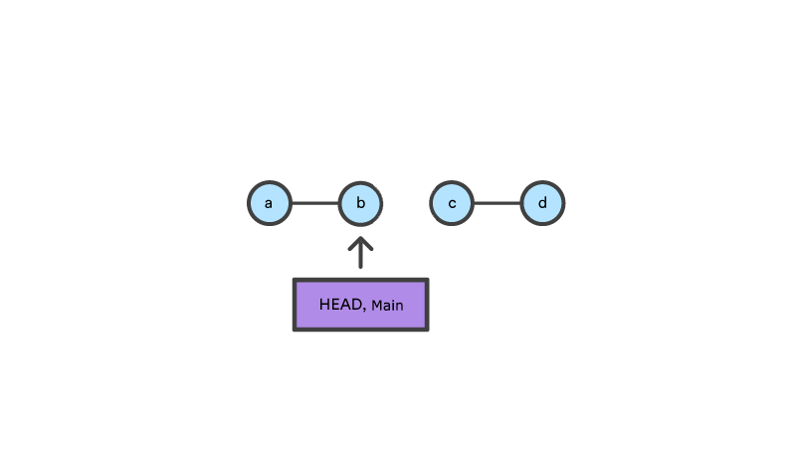
www.knoldus.com
Example
git checkout b
With git checkout, the main ref is still pointing to d. The HEAD ref has been moved,
and now points at commit b. The repo is now in a 'detached HEAD' state.
git reset b
Git reset, moves both the HEAD and branch refs to the specified commit.

Slide 4
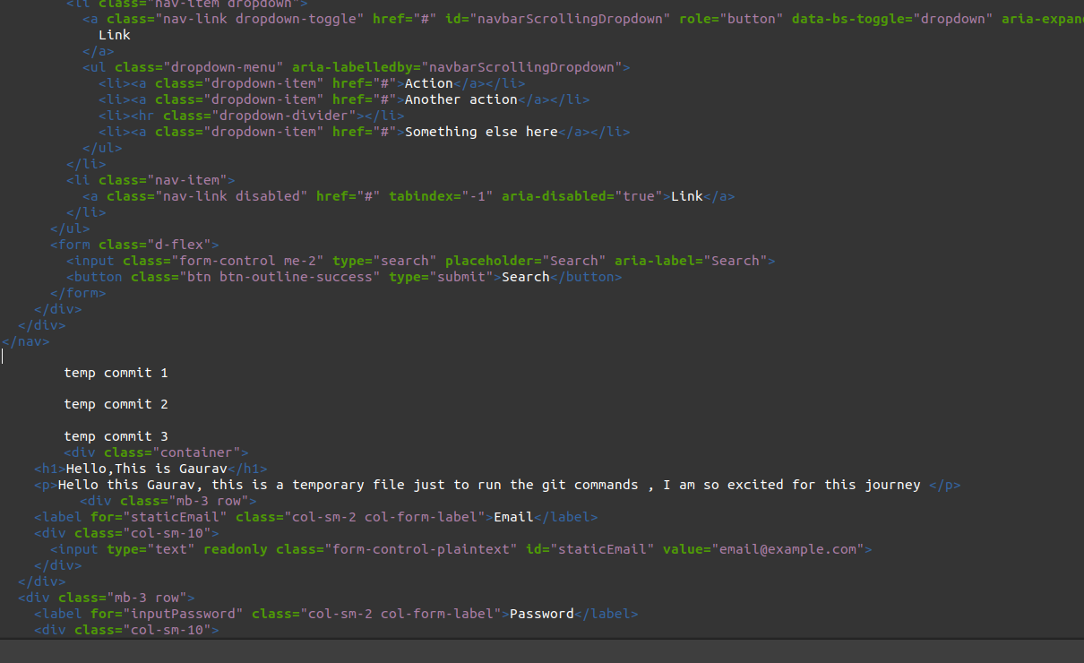
www.knoldus.com

Slide 5
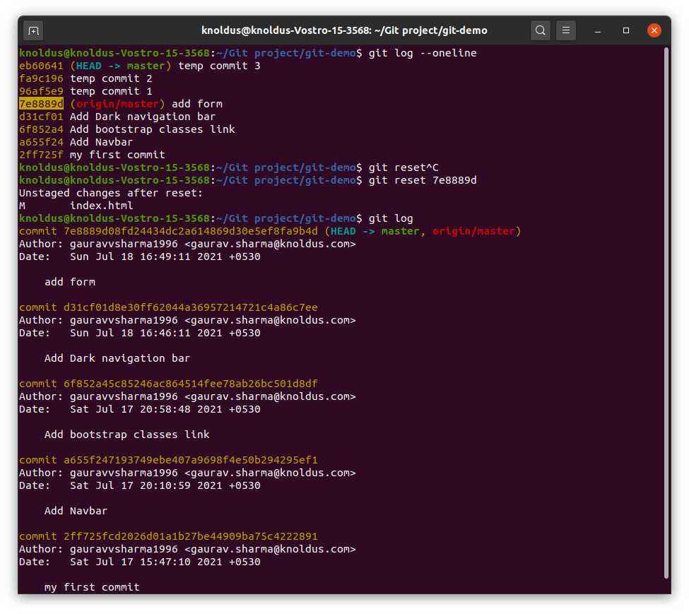
www.knoldus.com

Slide 6
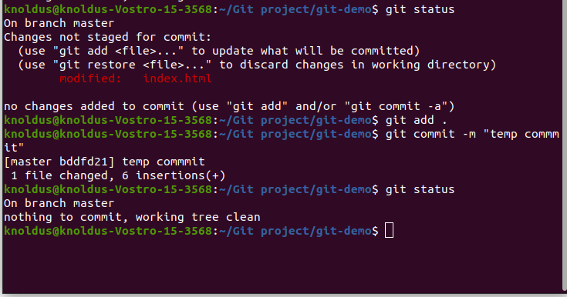
www.knoldus.com

Slide 7
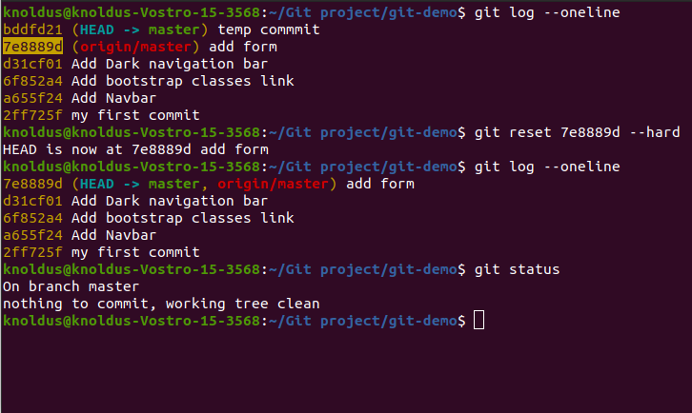
Hard Reset
www.knoldus.com

Slide 8
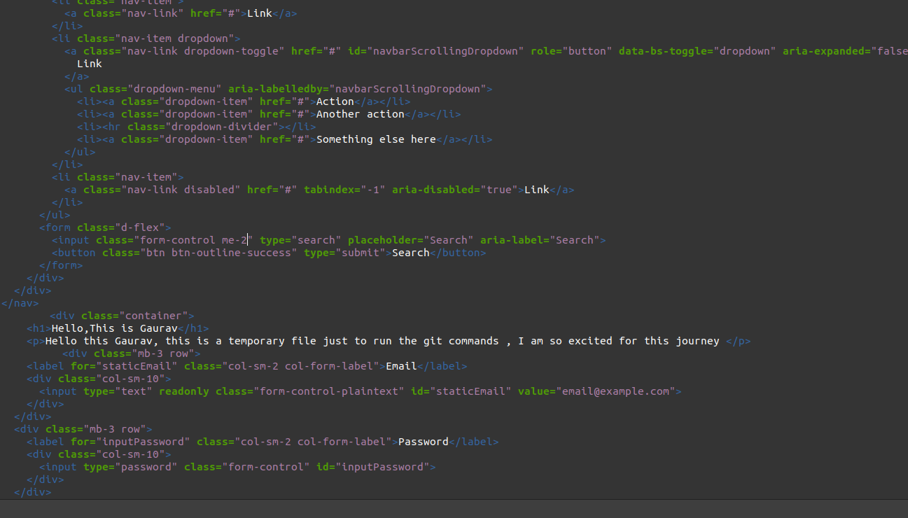
www.knoldus.com

Slide 9
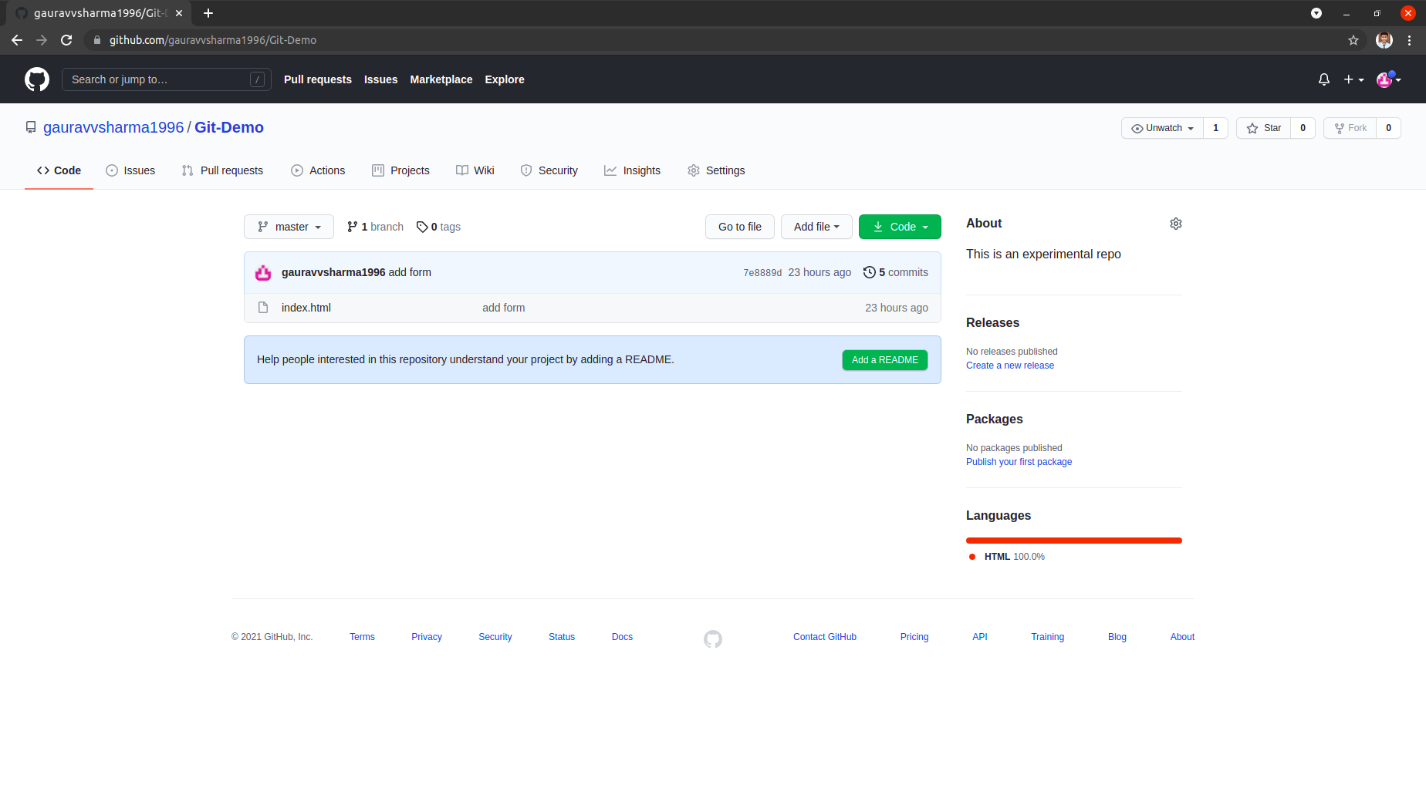

Slide 10
Repository Link
https://github.com/gauravvsharma1996/Git-Demo

Slide 11

Thank You!
Stay in Touch
facebook.com/templateparade
@Temparade
Bouleverd of Good Dream, 89898
+6288 2546 0845

